Slide 1
An Introduction to Database
Introduction to Database for Undergraduate Study
Lecture 3
Relational Database
Entity and Attributes
Keys and Relationships
This lecture and its associated materials have been produced by Mr. Rohit Panday (M.Sc. IT, 10+ Years of Industry/Academic Experience) of iAcademy for the purposes of lecturing on the above described subject and the material should be viewed in this context. The work does not constitute professional advice and no warranties are made regarding the information presented. The Author and iAcademy do not accept any liability for the consequences of any action taken as a result of the work or any recommendations made or inferred. Permission to use any of these materials must be first granted by iAcademy.

Slide 2
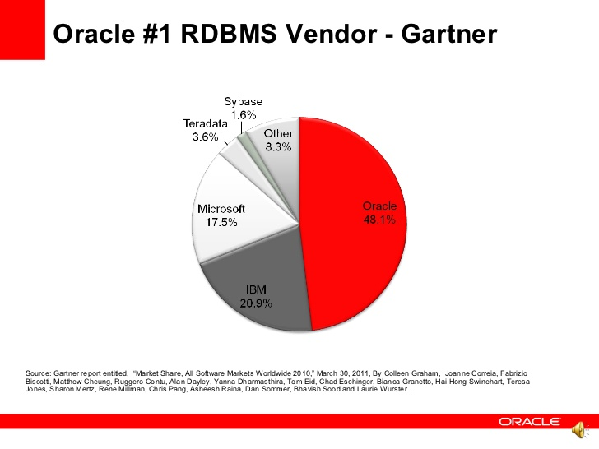
World Scenario
At present, the database market is completely dominated by systems supporting the relational model of data
For every minute Amazon.com is down, the company loses $66,240 - Forbes

Slide 3
Top Vendors
Oracle
[Oracle]
Microsoft
[SQL Server]
IBM
[DB2]
Sybase
PostgreSQL
MariaDB
MySQL
Teradata
Informix

Slide 4
Reminder – Last Week
What is a Database ?
What does a Database Management System does ?
What does a Database do ?
History of Database Models.
Levels of Abstraction

Slide 5

Agendas
Definition & Concepts
  Relational Database
  Entity
  Attributes
  Types of Attributes
  Constraints
Database
  Functions
  Types/Models
  Abstraction

Slide 6
Relational Database - Definition
The notion ‘ relational’ is motivated my mathematical concept of a relation. Relations in mathematics are set of tuples.
Relational databases are collections of one or more relations
In practice, relations can be visualized as tables, the rows of which are individual records of data with same field structure

Slide 7
Entity
An object that exist
Type of object that can store data
Entity is one member/instance of entity type

Slide 8
Entity
EMPLOYEE
ACCOUNT
BOOK

Slide 9
Attribute
Defines Property of Entity
Serves to qualify/quantity the Entity

Slide 10
Attribute
Defines Property of Entity
Serves to qualify/quantity the Entity
EMPLOYEE
ACCOUNT
BOOK
Name
Position
Name
Balance
ISBN
Name

Slide 11
Attribute - Types
Single [ISBN for BOOK]
Composite [Name – First/Middle/Last]
Derived [Age – Date of Birth]
Multi Value [Address – Street, Area, City]

Slide 12
Attribute - Access
Data Type | Description
Text | Use for text or combinations of text and numbers. 255 characters maximum
Memo | Memo is used for larger amounts of text. Stores up to 65,536 characters.
Byte | Allows whole numbers from 0 to 255
Integer | Allows whole numbers between -32,768 and 32,767
Long | Allows whole numbers between -2,147,483,648 and 2,147,483,647
Single | Single precision floating-point. Will handle most decimals
Double | Double precision floating-point. Will handle most decimals
Currency | Use for currency. Holds up to 15 digits of whole dollars, plus 4 decimal places.

Slide 13
Attribute - Access
Data Type | Description
AutoNumber | AutoNumber fields automatically give each record its own number, usually starting at 1
Date/Time | Use for dates and times
Yes/No | A logical field can be displayed as Yes/No, True/False, or On/Off. In code, use the constants True and False (equivalent to -1 and 0)
Ole Object | Can store pictures, audio, video, or other BLOBs (Binary Large OBjects)
Hyperlink | Contain links to other files, including web pages
Lookup Wizard | Let you type a list of options, which can then be chosen from a drop-down list

Slide 14
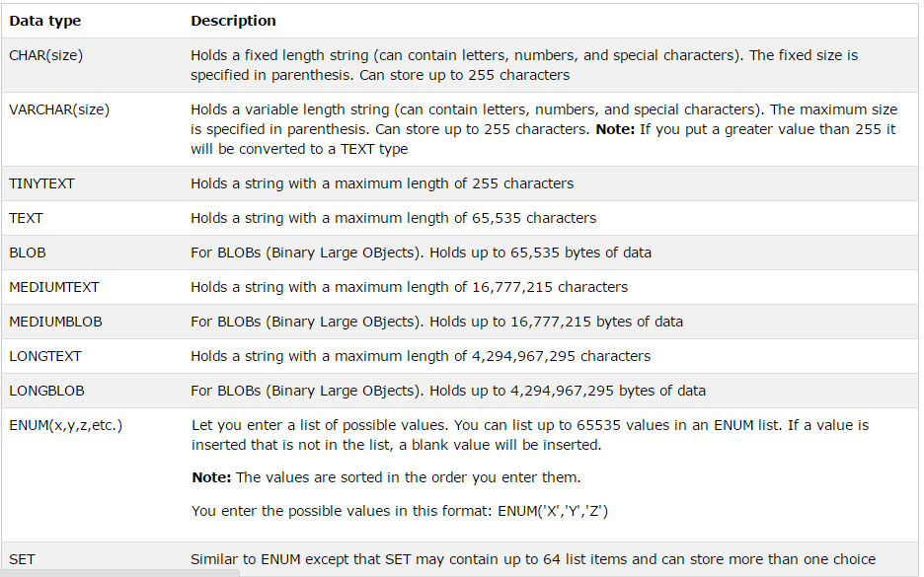
Attribute - MySQL

Slide 15
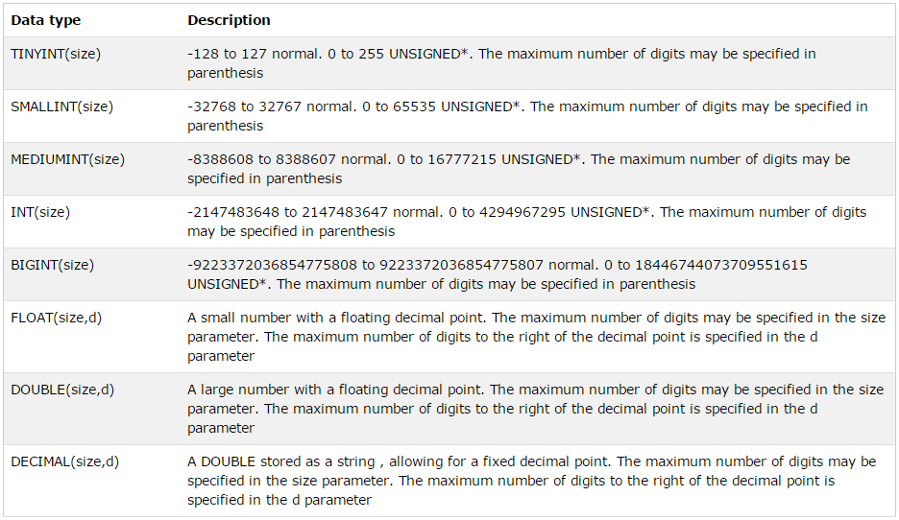
Attribute – Access [Number]

Slide 16
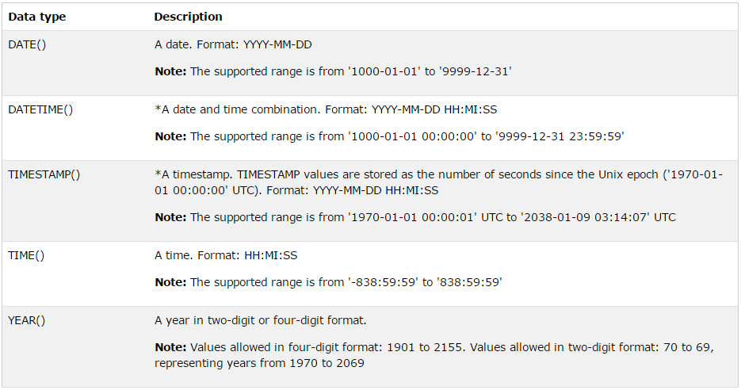
Attribute – Access [Date]

Slide 17
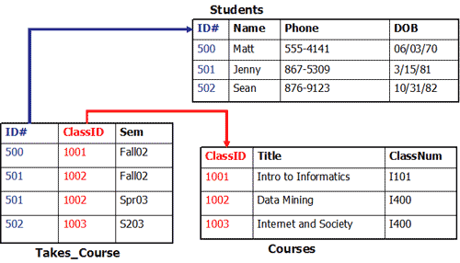
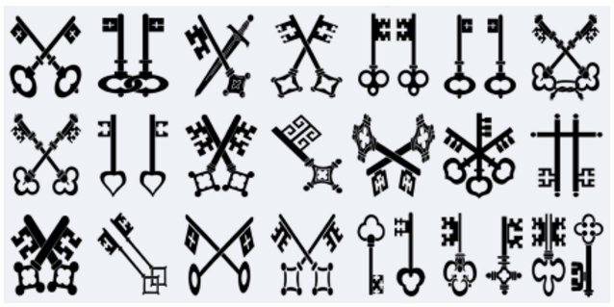
Constraints - Keys
Keys are, as their name suggests, a key part of a relational database and a vital part of the structure of a table. They ensure each record within a table can be uniquely identified by one or a combination of fields within the table. They help enforce integrity and help identify the relationship between tables.

Slide 18
Key - Types
PRIMARY
KEY
uniquely identify each row in the table
the columns must be unique, not null and not empty
FOREIGN
KEY
refers to the primary key in another table

Slide 19
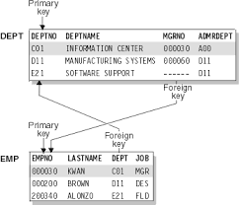
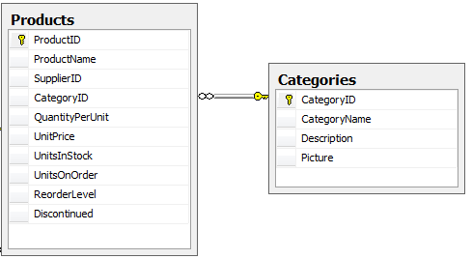
Primary Key and Foreign Key

Slide 20
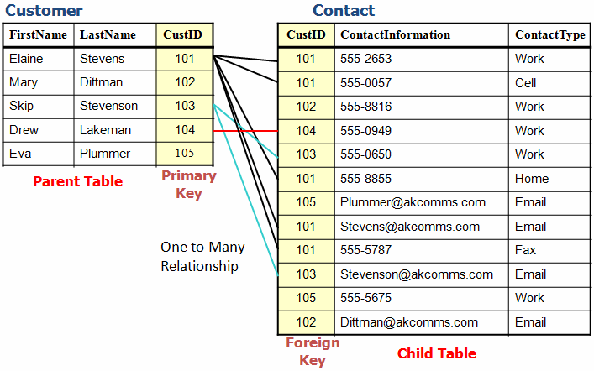
Primary Key and Foreign Key

Slide 21
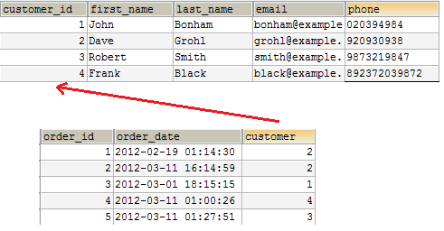
Primary Key and Foreign Key

Slide 22
Key Concepts
PRIMARY KEY
FOREIGN KEY

Slide 23
Connectivity and Cardinality
Connectivity
cardinality refers to the uniqueness of data values contained in a particular column (attribute) of a database table. The lower the cardinality, the more duplicated elements in a column.
EMPLOYEE
DEPARTMENT
Cardinality

Slide 24
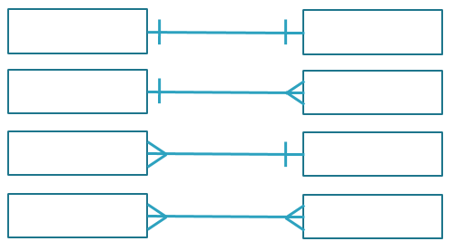
Cardinality - Degree
One-to-One (1:1)
One-to-Many (1:M)
Many-to-One(M:1)
Many-to-Many(M:N)

Slide 25

Relationship Types - Optionality
Department May have NO Employees

Slide 26
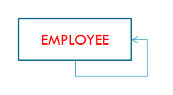
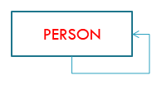
Relationship Types – Unary
Employee
MANAGES
Employee
Person
MARRIES
Person

Slide 27



Relationship Types – Binary
RECEIVES
CONTAINS
SUPPLIES

Slide 28
Relationship Types – Ternary
SKILL
1
2
PROJECT
3
EMPLOYEE
1
Skill used by Employee on Project
2
Project has Employee using this Skill
3
Employee uses Skill on Project

Slide 29
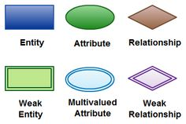
Key Symbols

Slide 30
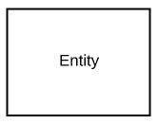
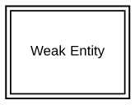
 | Strong entity | These shapes are independent from other entities, and are often called parent entities, since they will often have weak entities that depend on them. They will also have a primary key, distinguishing each occurrence of the entity.
 | Weak entity | Weak entities depend on some other entity type. They don't have primary keys, and have no meaning in the diagram without their parent entity.

Slide 31
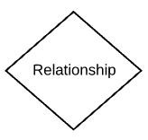

 | Relationship | Relationships are associations between or among entities.
 | Weak relationship | Weak Relationships are connections between a weak entity and its owner.

Slide 32
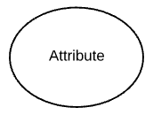
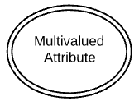
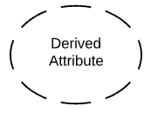
 | Attribute | Attributes are characteristics of an entity, a many-to-many relationship, or a one-to-one relationship.
 | M Multivalued attribute | Multivalued attributes are those that are can take on more than one value.
 | Derived attribute | Derived attributes are attributes whose value can be calculated from related attribute values.

Slide 33
Questions ?
What is a Database ?
What does a Database Management System does ?
What does a Database do ?
History of Database Models.
Levels of Abstraction

Slide 34
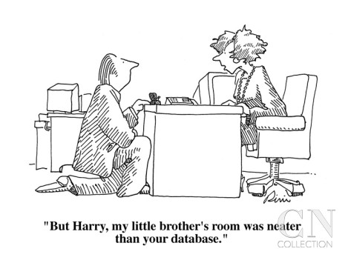
Laugh

Slide 35

End of Lecture for Week - 3

